Slide 1
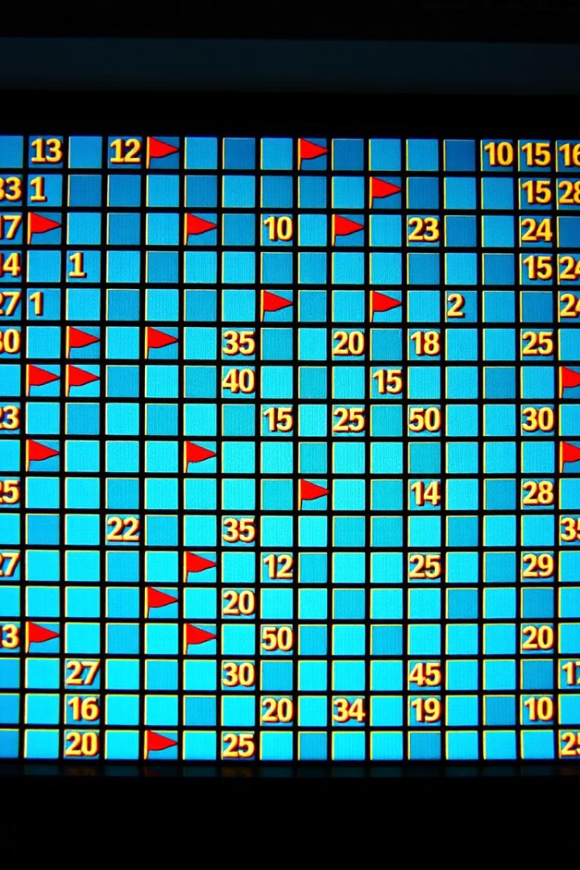
Minesweeper
A charming puzzle game loved globally. It blends simple rules with complex tactics. Discover its rich history, gameplay mechanics, and hidden depth.
NAME: M.G.N.Harshith Varma
Roll No: 23951A052S

Slide 2
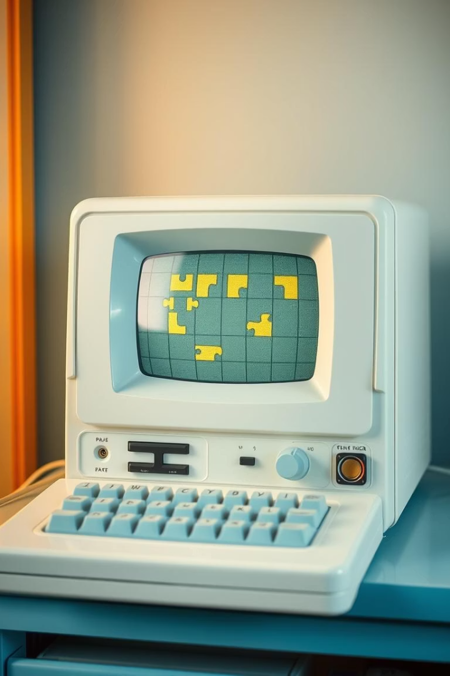
Minesweeper Origins: From Mainframe to Windows
Training Purpose
Designed to improve mouse skills and logical thinking.
Key Creator
Programmed originally by Robert Donner.

Slide 3

Gameplay Basics: Unveiling the Grid
Clear the Board
Number Clues
Avoid mines to win.
Reveal how many mines are nearby.
Flagging Mines
Logic-driven Play
Mark suspected mine positions.
Use deduction to advance safely.

Slide 4
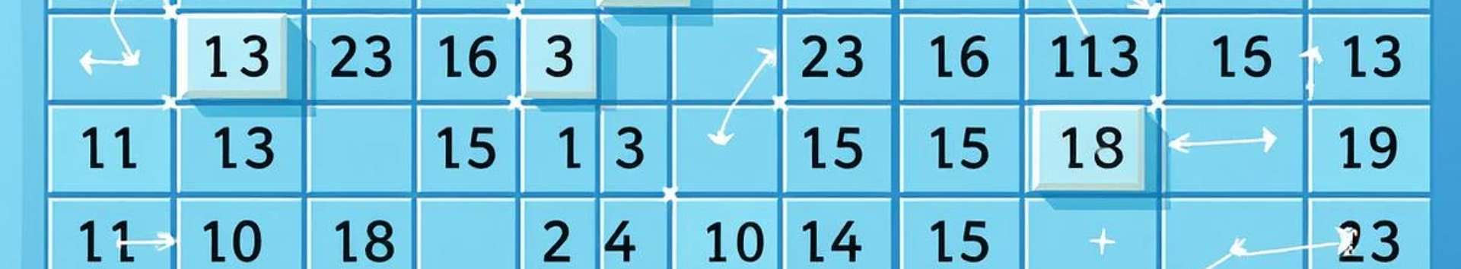
The Math of Minesweeper: Probability and Logic
Research
Complexity
Richard Kaye’s "Minesweeper is NP-complete" paper explored this.
Boolean Algebra
The game is NP-complete—solving any board is tough.
Mine Density
Helps determine safe or mined spots logically.
Calculating chances refines moves.

Slide 5


GITHUB LINK: GitHub
WEB APP LINK : MineSweeper

Slide 6
ALGORITHM:
Board prepared -> Mines placed -> Neighbour numbers updated.
2. Player makes move (row, column).
3. If mine -> Game over.
4. If safe:
- Reveal the cell.
- If it's '0', auto-reveal empty neighbours.
5. Repeat until win or loss.

Slide 7

Speedrunning Minesweeper: Mastering the Game
1
Global Community
Leaderboards track fastest times worldwide.
2
Advanced Techniques
Top players use refined strategies and quick reflexes.
3
Record Speed
Kamil Murańka set a 28.34-second expert record.

Slide 8

Minesweeper: A Timeless Classic
Simple Yet Deep
Rules are easy, but challenges never end.
Enhances Logic
Boosts problem-solving and critical thinking skills.
Enduring Appeal
Still popular after 30+ years.
Get Started
Download and enjoy this classic today!

Slide 9
THANK YOU

